Slide 1
BEHOLDER Attractiveness in Human Faces
Springboard Data Science Capstone Project II
Akiro Semtei-Rotundo

Slide 2
INTRODUCTION
Human attractiveness appraisal highly subjective and studied in areas like psychology, sociology, neuroscience and now data since too.
Computationally complex requires a CNN output to a Dense network that ends with a simple a linear activation.
Possible to expand results to incorporate a generative adversarial network

Slide 3
OBJECTIVE
To estimate facial beauty attractiveness according to an average onlooker
To create a reference database that can be used for further attractiveness studies as a benchmark for results.

Slide 4
DATA ACQUISITION
DATASET 1
The first dataset contains images labelled with beauty scores ranging from [1, 5] by totally 60 volunteers, and 86 facial landmarks are also located to the significant facial components of each images.
DATASET 2
The second dataset has images of 102 adult faces 1350x1350 pixels in full colour. Self-reported age, gender and ethnicity are included in the file london_faces_info.csv.
DATASET 3
The final dataset is This database contains 10,168 natural face photographs and several measures for 2,222 of the faces, including memorability scores, computer vision and psychology attributes, and landmark point annotations.

Slide 5
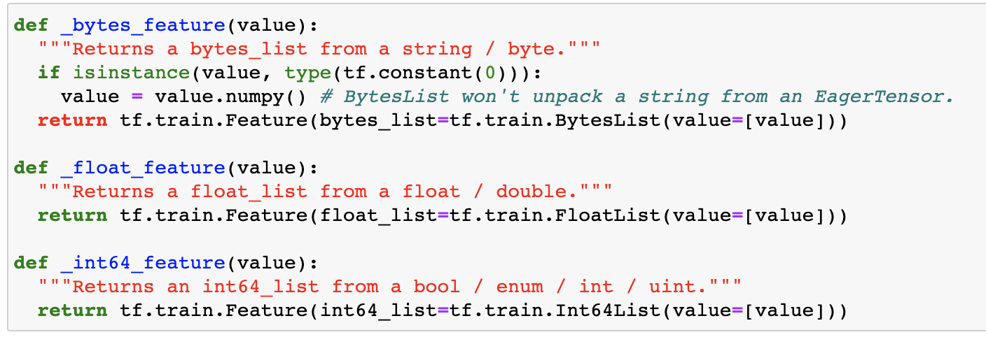
DATA MANIPULATION
In order to run our experiment efficiently we want to join the SCUT, LONDON, and 10K databases into a single data frame, train_label_df, that has all the randomly sorted image names in column 1 and the attributes normalised to a scale of [1-9].
We then utilise 3 helper functions that allow us to decode all the information into bytecode -for the images’

Slide 6
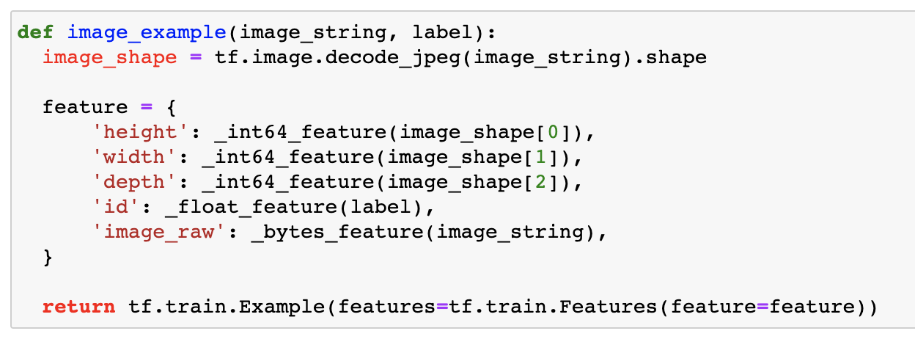
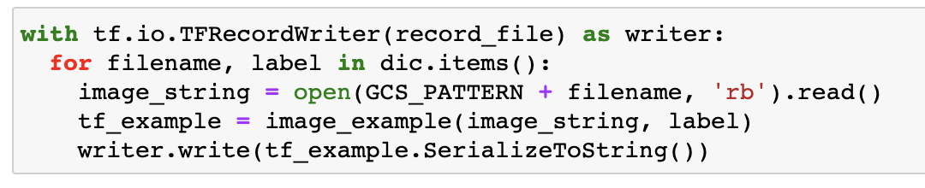
DATA MANIPULATION
Then we build a function that will decode a single image and use the helper functions to write all the information into a tf.example, which is a single record in a TFRecord dataset.
The final step is to pass the information by a writer or TFRecord generator

Slide 7
THE MODEL
All image data is transformed to bytecode and stored in the input tensor
All attractiveness attributes are scaled [1,9] and are stored in the output tensor
We build a transfer learning model under the TPUStrategy based on the NASNET-Large pretrained model

Slide 8
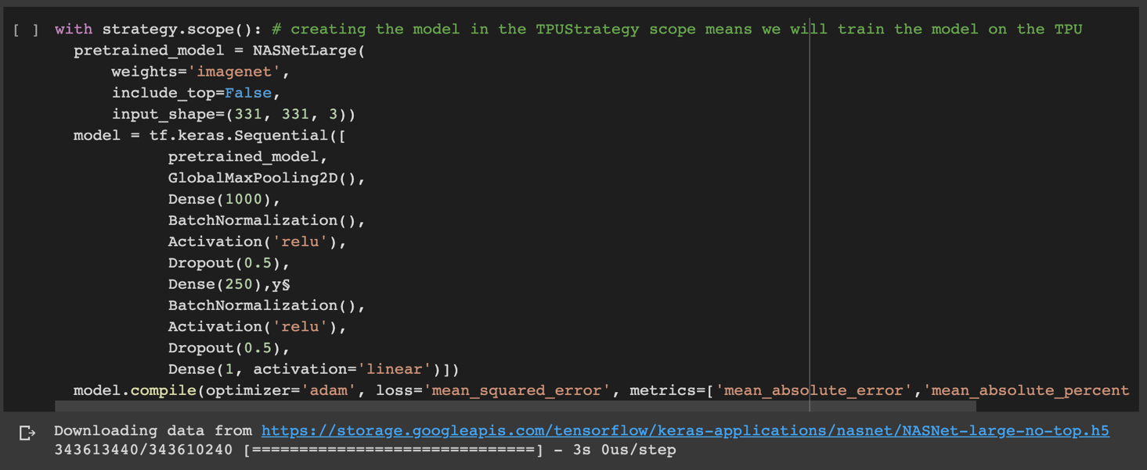
THE MODEL

Slide 9
RESULTS
NASNET-Large
MSE (avg last 5 epochs) 0.597
MSE (best) 0.430
MSE (test dataset ) 0.661

Slide 10
USING THE MODEL
Benchmark analysis was performed for the beauty scores, and the data reveals the efficacy of CNN networks for this type of problem. Our experiment results in a model that can be run against any human face, male or female, and will return an accurate representation of its attractiveness.

Slide 11
CONCLUSIONS
Our model provides very accurate results, but it is tied to limitations. The requirements to get an accurate reading on a face attractiveness are a posed face, either smiling or resting, a simple background, and a straight neutral angle facing the camera head-on. This are limitations that can be worked around by enriching the images with random rotations, saturations, crops and other manipulations that could be a continuation of the work presented herein.

